Slide 1

TITLE :
PATIENTS WITH DOWN SYNDROME ATTENDING IN OUT PATIENT
DEPARTMENT SHISHU BIKASH KENDRO,
DHAKA MEDICAL COLLEGE HOSPITAL, 2021
DR.TOSHIBA RAHMAN
MBBS,DCH,FCPS(Paediatrics)
MEDICAL OFFICER
SHISHU BIKASH KENDRO
DHAKA MEDICAL COLLEGE HOSPITAL

Slide 2
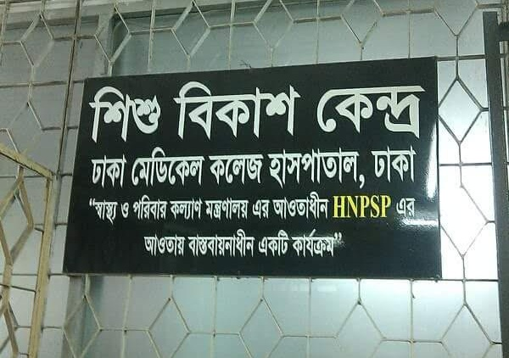

Slide 3

Brief History of SBK
SBK STARTED WITH ONLY 5 BRANCHES IN BANGLADESH SINCE 2009. BUT AT THE PRESENT THERE ARE 35 OPERATING BRANCHES RUNNING THROUGHOUT THE COUNTRY WHICH CATERS TO THE BENEFITS FOR DISABLE AND CHALLENGING CHILDREN.

Slide 4
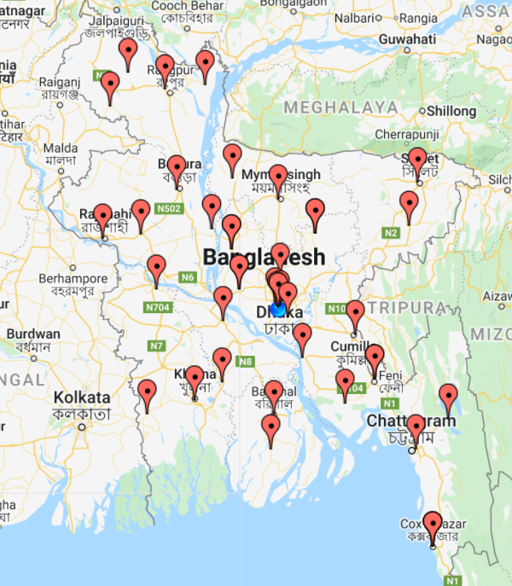

Slide 5
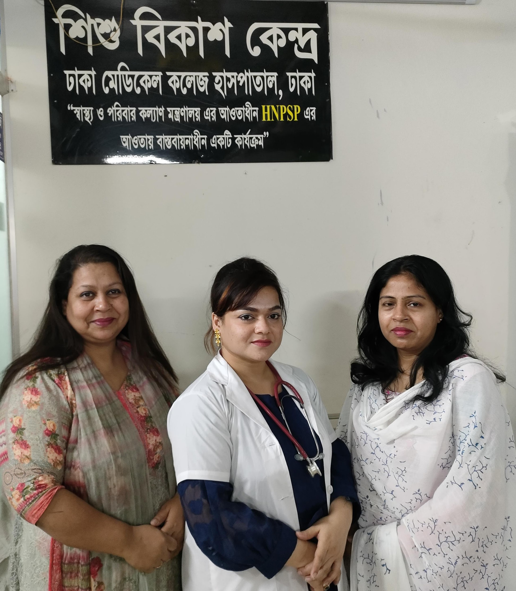
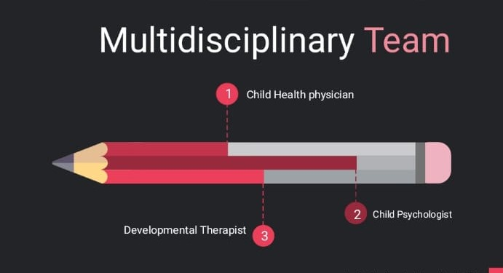

Slide 6
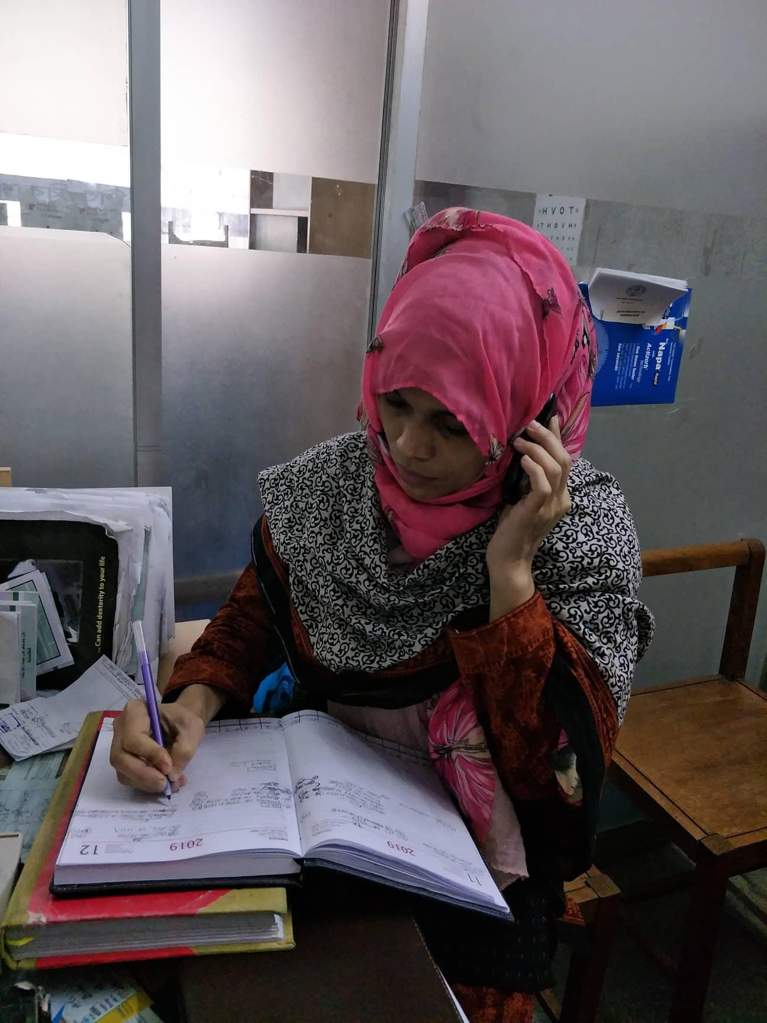
  DEALING WITH PATIENTS PARENT’S QUERIES.
  SUBMIT IN DEPTH INFORMATION TO DGHS, PAEDIATRIC DEPARTMENT ABOUT PATIENTS QUANTITY, CATEGORIZATION MONTHLY & YEARLY.
  MAINTAIN OF THE APPOINTMENTS SCHEDULE OF THE PATIENTS OVER PHONE CALLS ALSO.

Slide 7
VISION OF SBK
TO PREVENT DISABILITY
TO OPTIMIZE DEVELOPMENT
TO IMPROVE THE QUALITY OF LIFE
TO REDUCE MORBIDITY

Slide 8
PRESENT SERVICES PROVIDED AT SBK
THERAPEUTIC INTERVENTION FOR AUTISM
MOTOR THERAPY
EPILEPSY CLINIC
SEATING & FEEDING CLINIC
SPEECH & LANGUAGE COMMUNICATION THERAPY CLINIC
LOW VISION CLINIC
WELL-BABY CLINIC
MENTAL HEALTH CLINIC

Slide 9
Saturday | Sunday | Monday | Tuesday | Wednesday | Thursday
More than Word clinic | Sitting and feeding Clinic | Low vision clinic | Speech therapy Clinic | Epilepsy Clinic | Well Baby Clinic
Psychological assessment (PA) | Psychological assessment (PA) | Psychological assessment (PA) | Psychological assessment (PA) | Psychological assessment (PA) | Psychological assessment (PA)
Walk-In-Clinic | Walk-In-Clinic | Walk-In-Clinic | Walk-In-Clinic | Walk-In-Clinic | Walk-In-Clinic
 | General Developmental Assessment Clinic (GDA) | General Developmental Assessment Clinic (GDA) |  | Psychosocial Counseling, Mental health Clinic | Psychosocial Counseling, Mental health Clinic

Slide 10
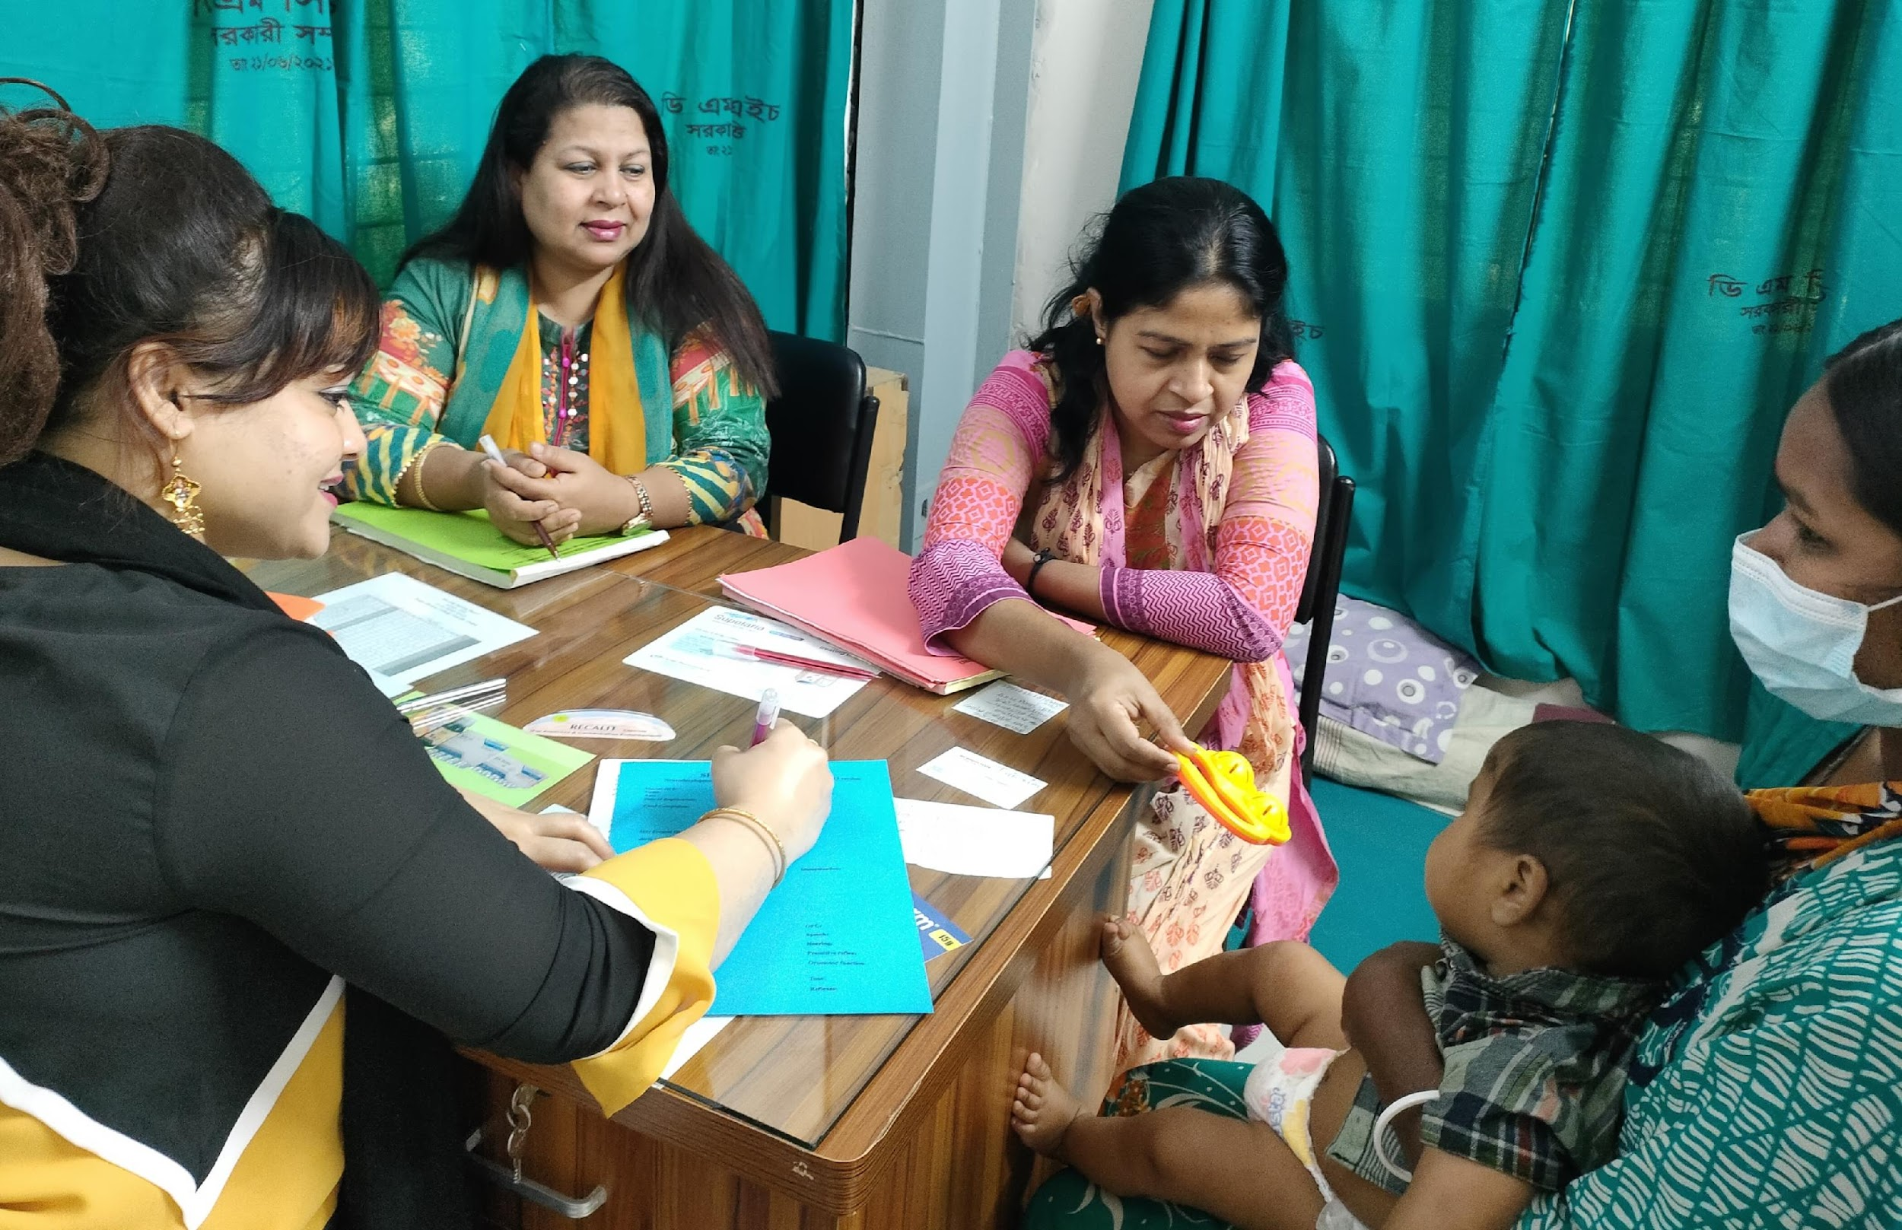

Slide 11
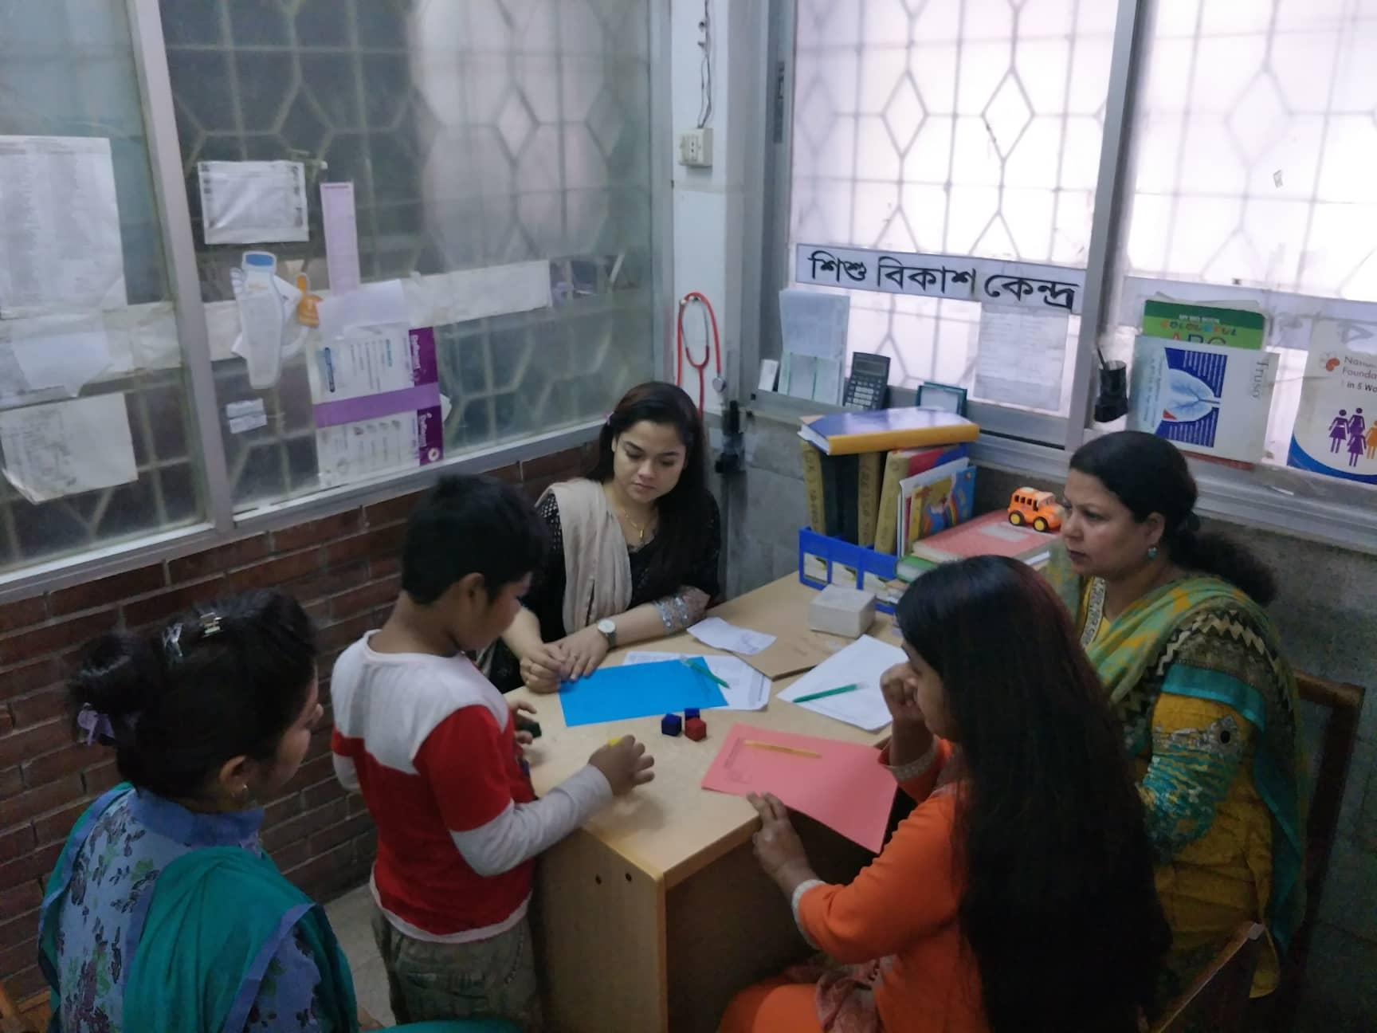


Slide 12
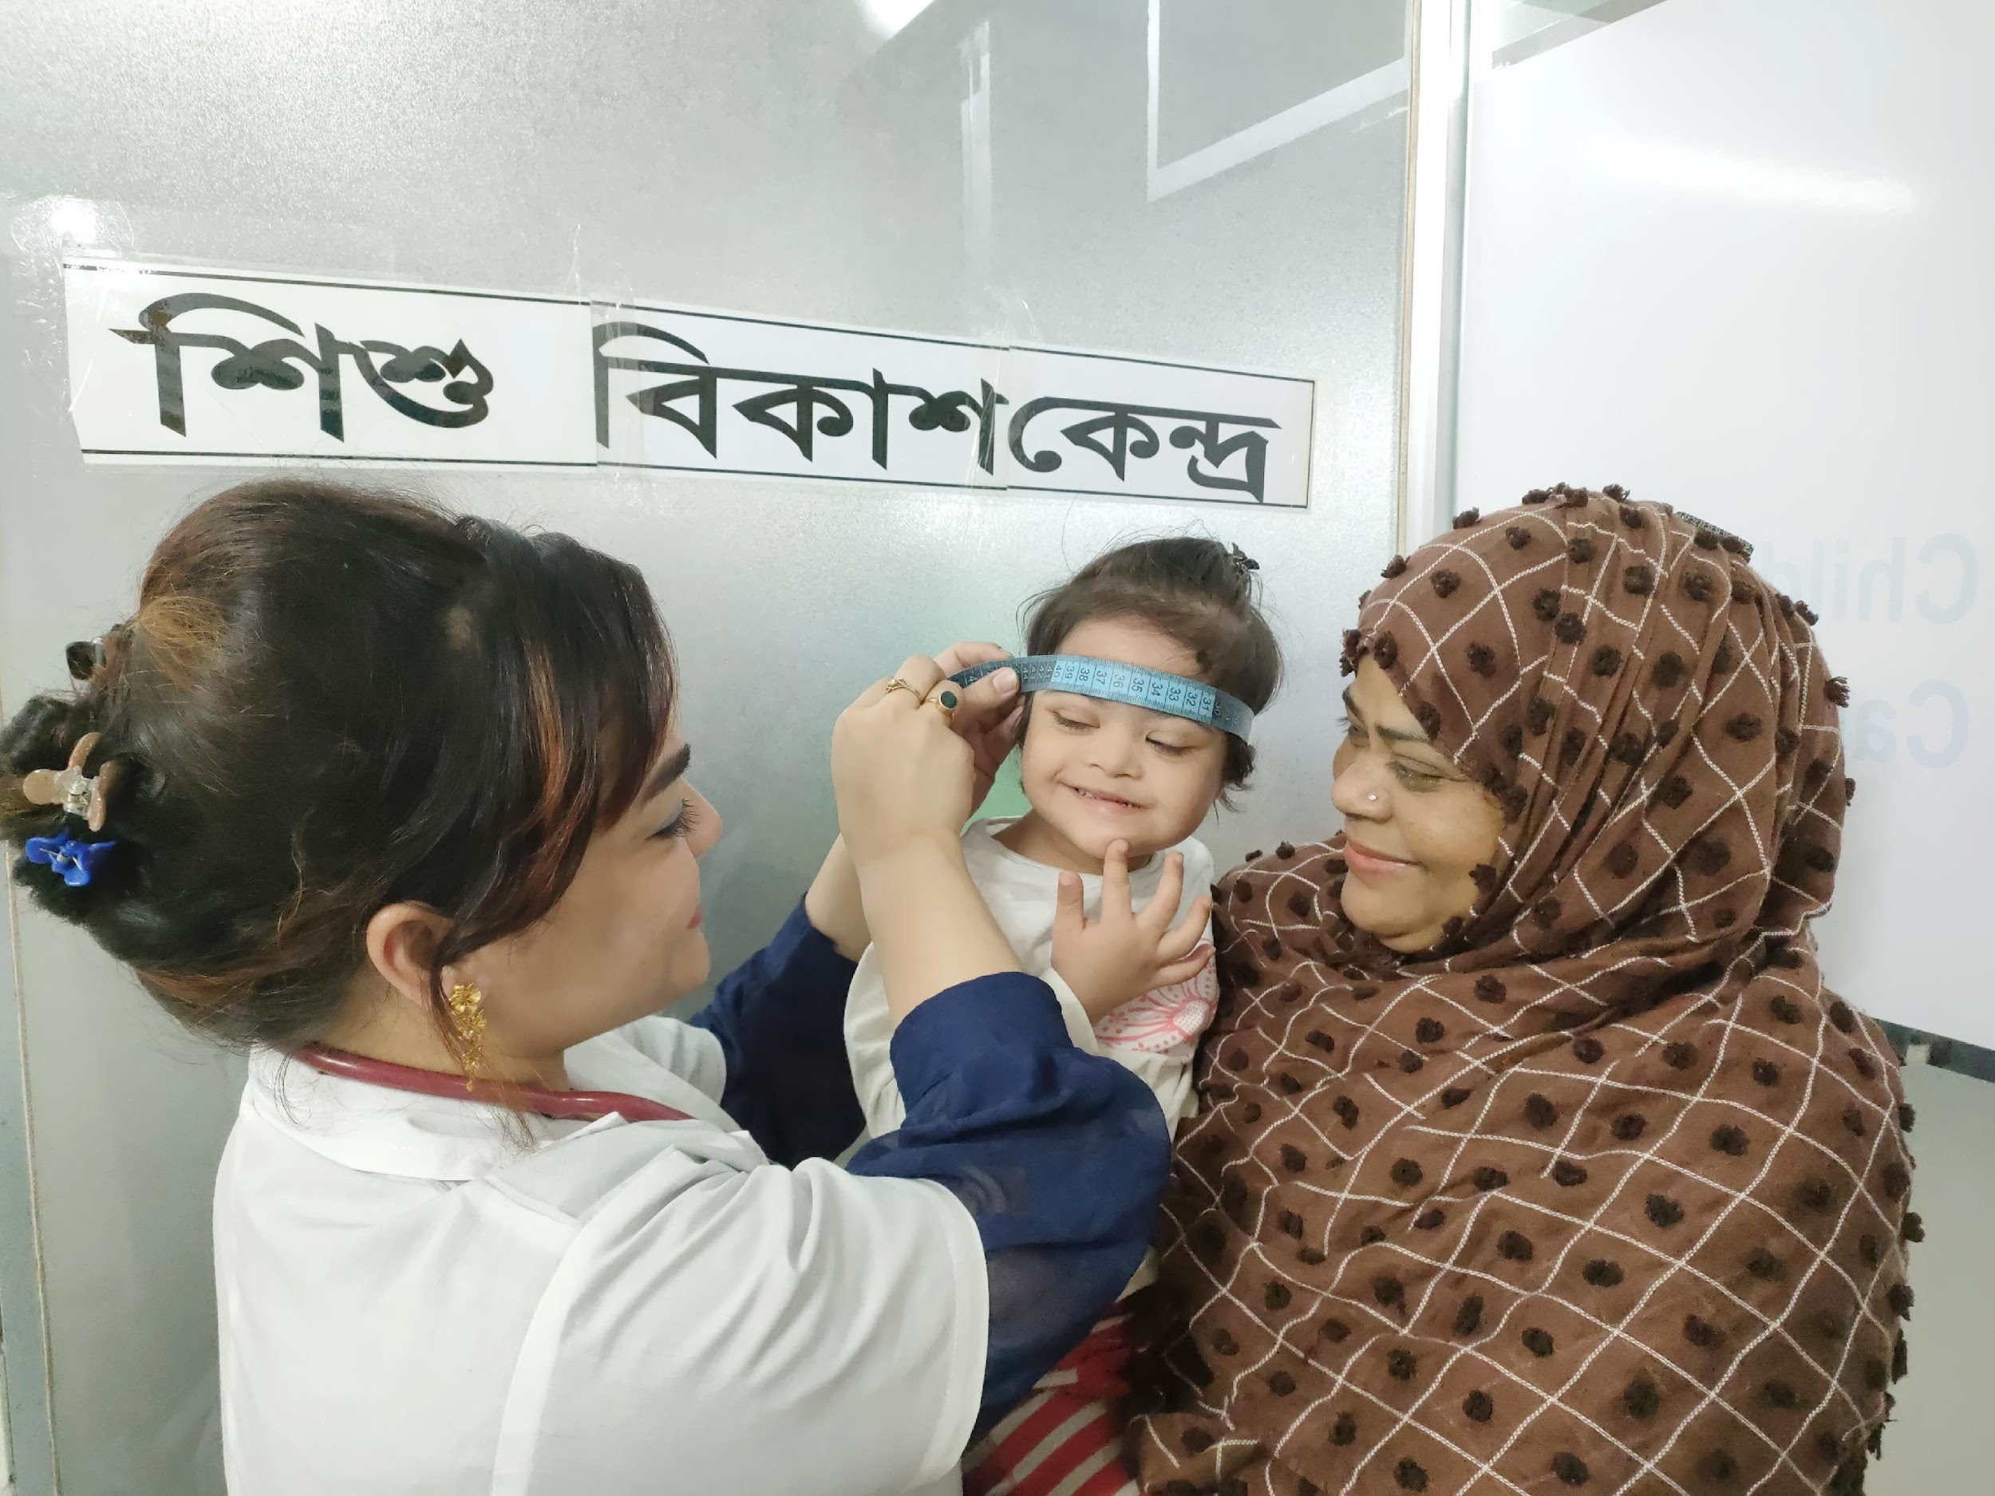
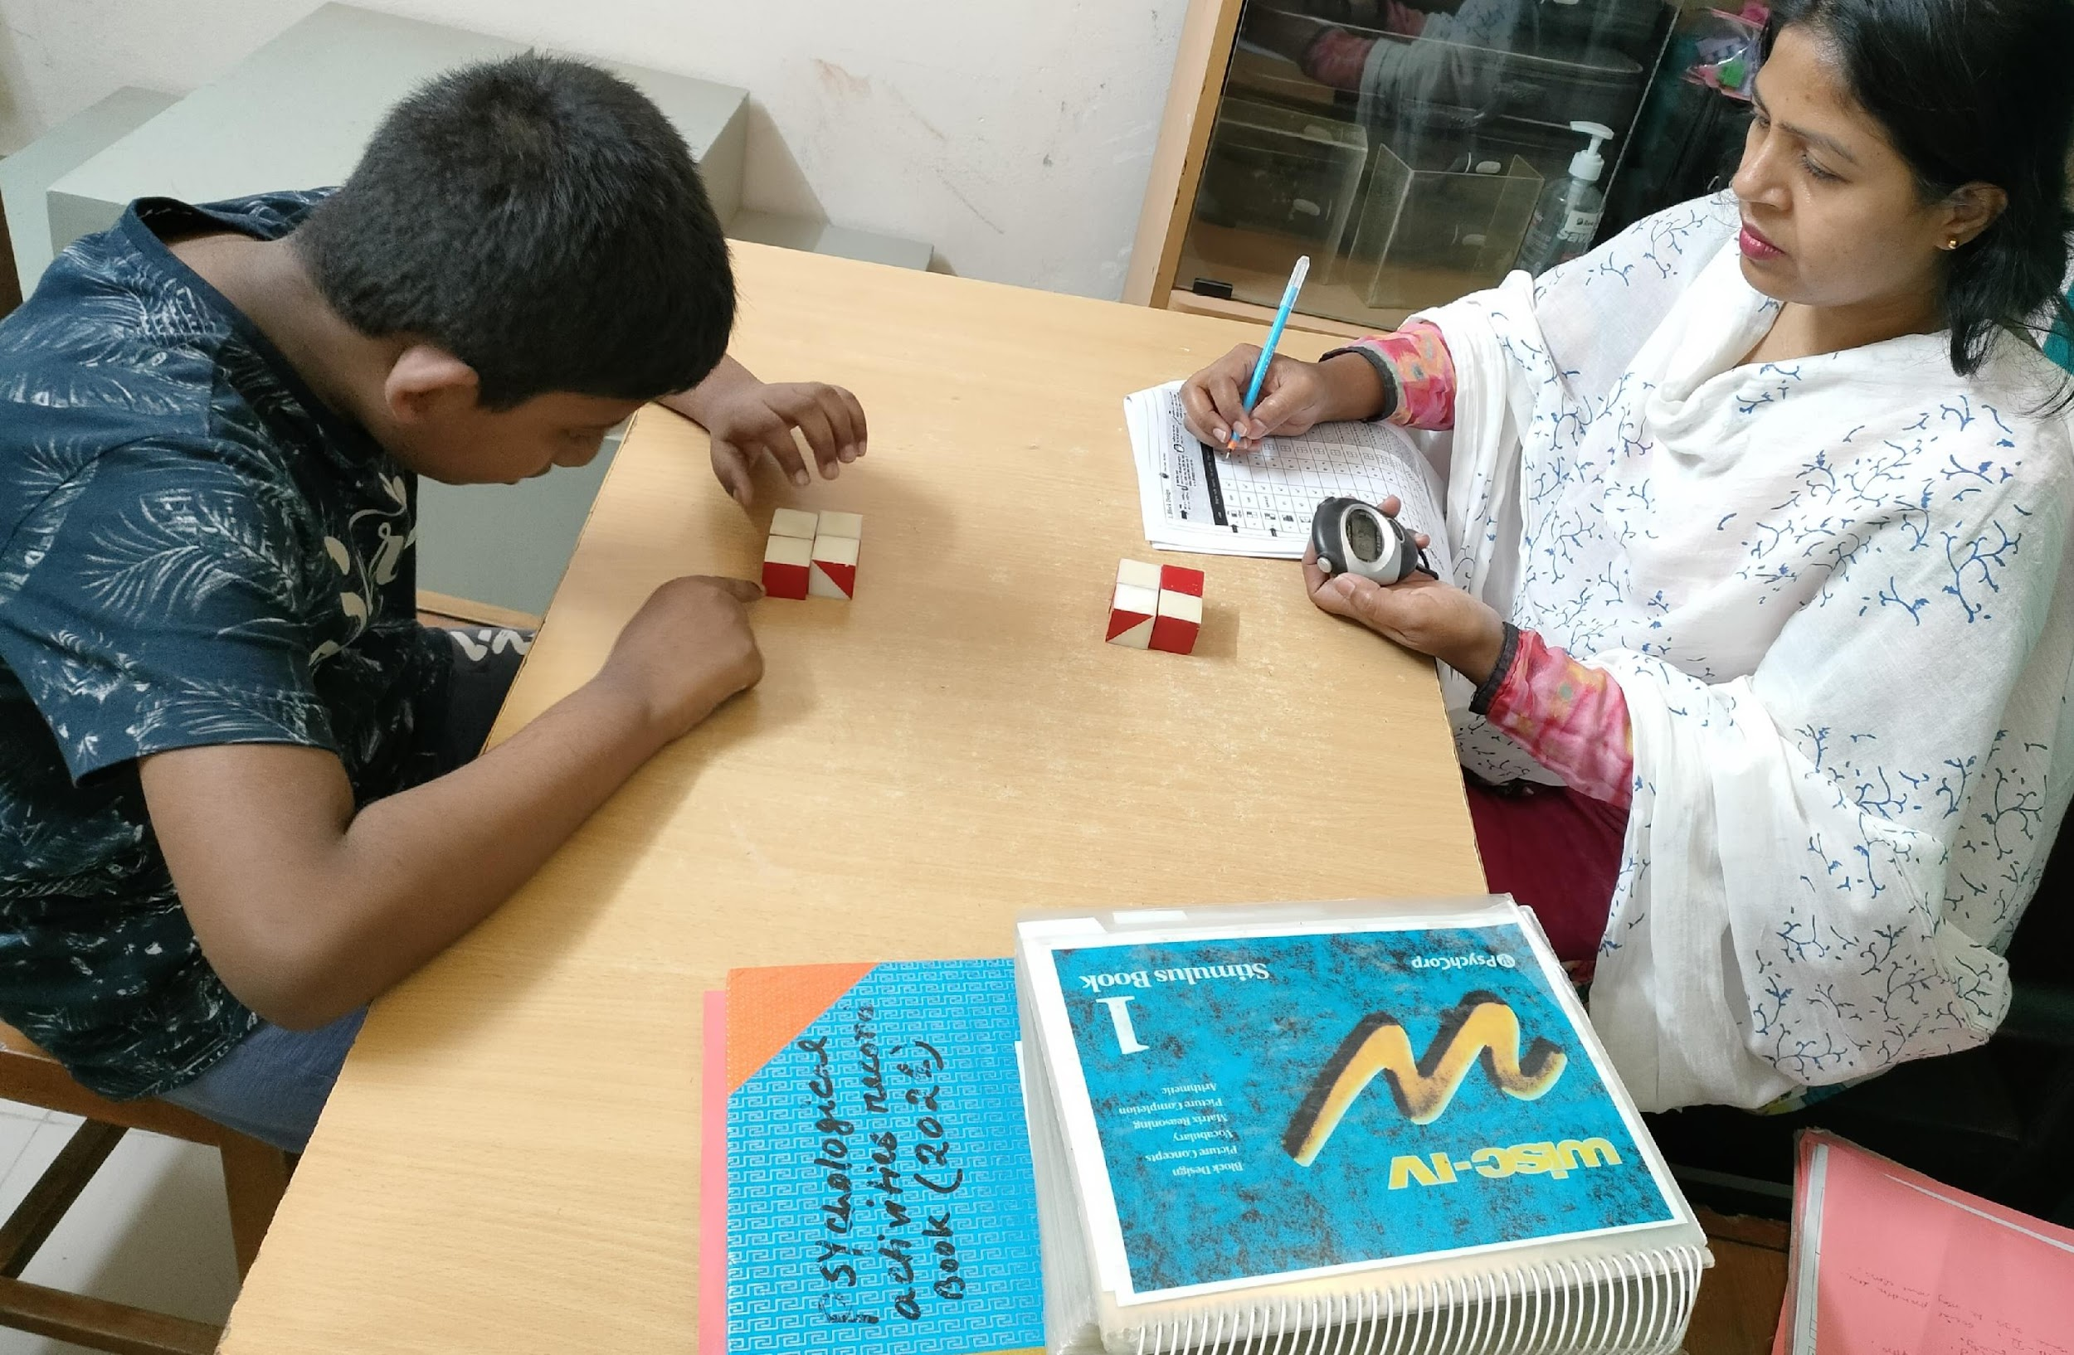
OUR ACTIVITIES

Slide 13
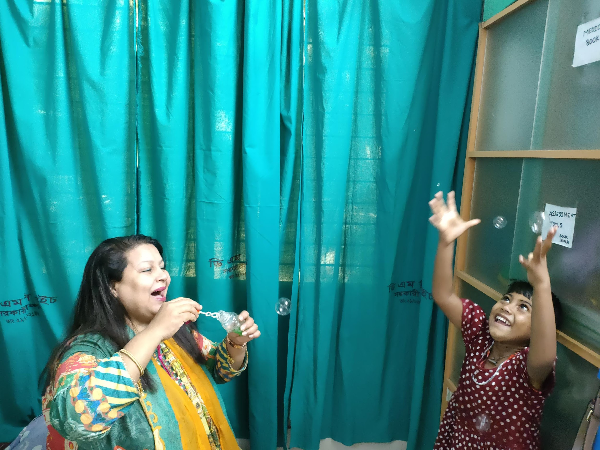
OUR ACTIVITIES

Slide 14
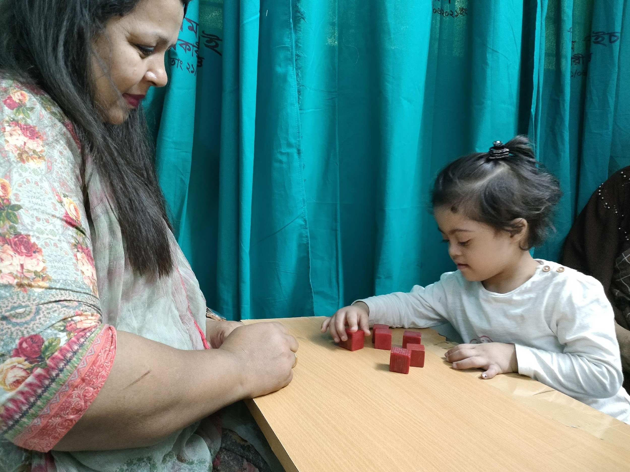
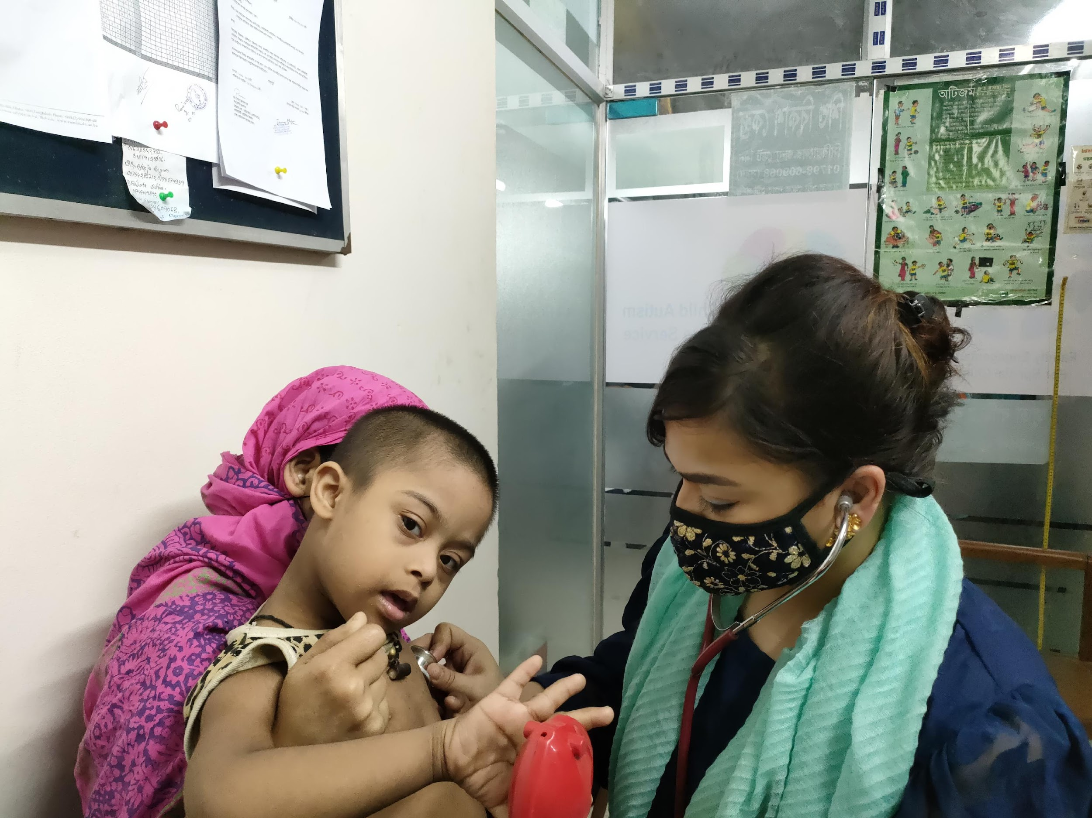
OUR ACTIVITIES

Slide 15
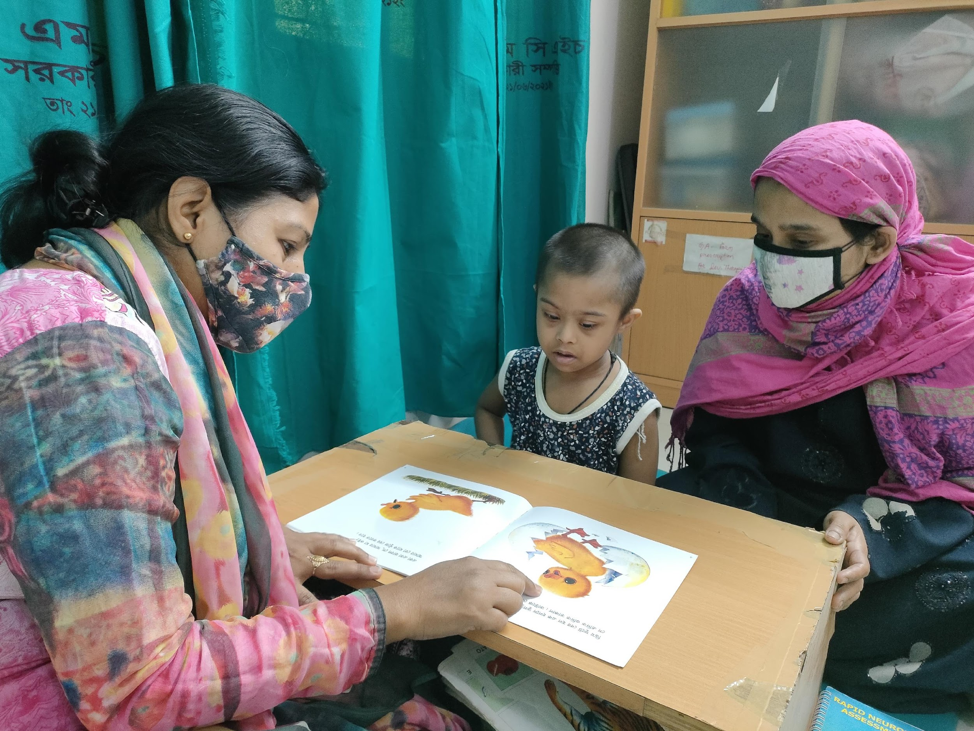
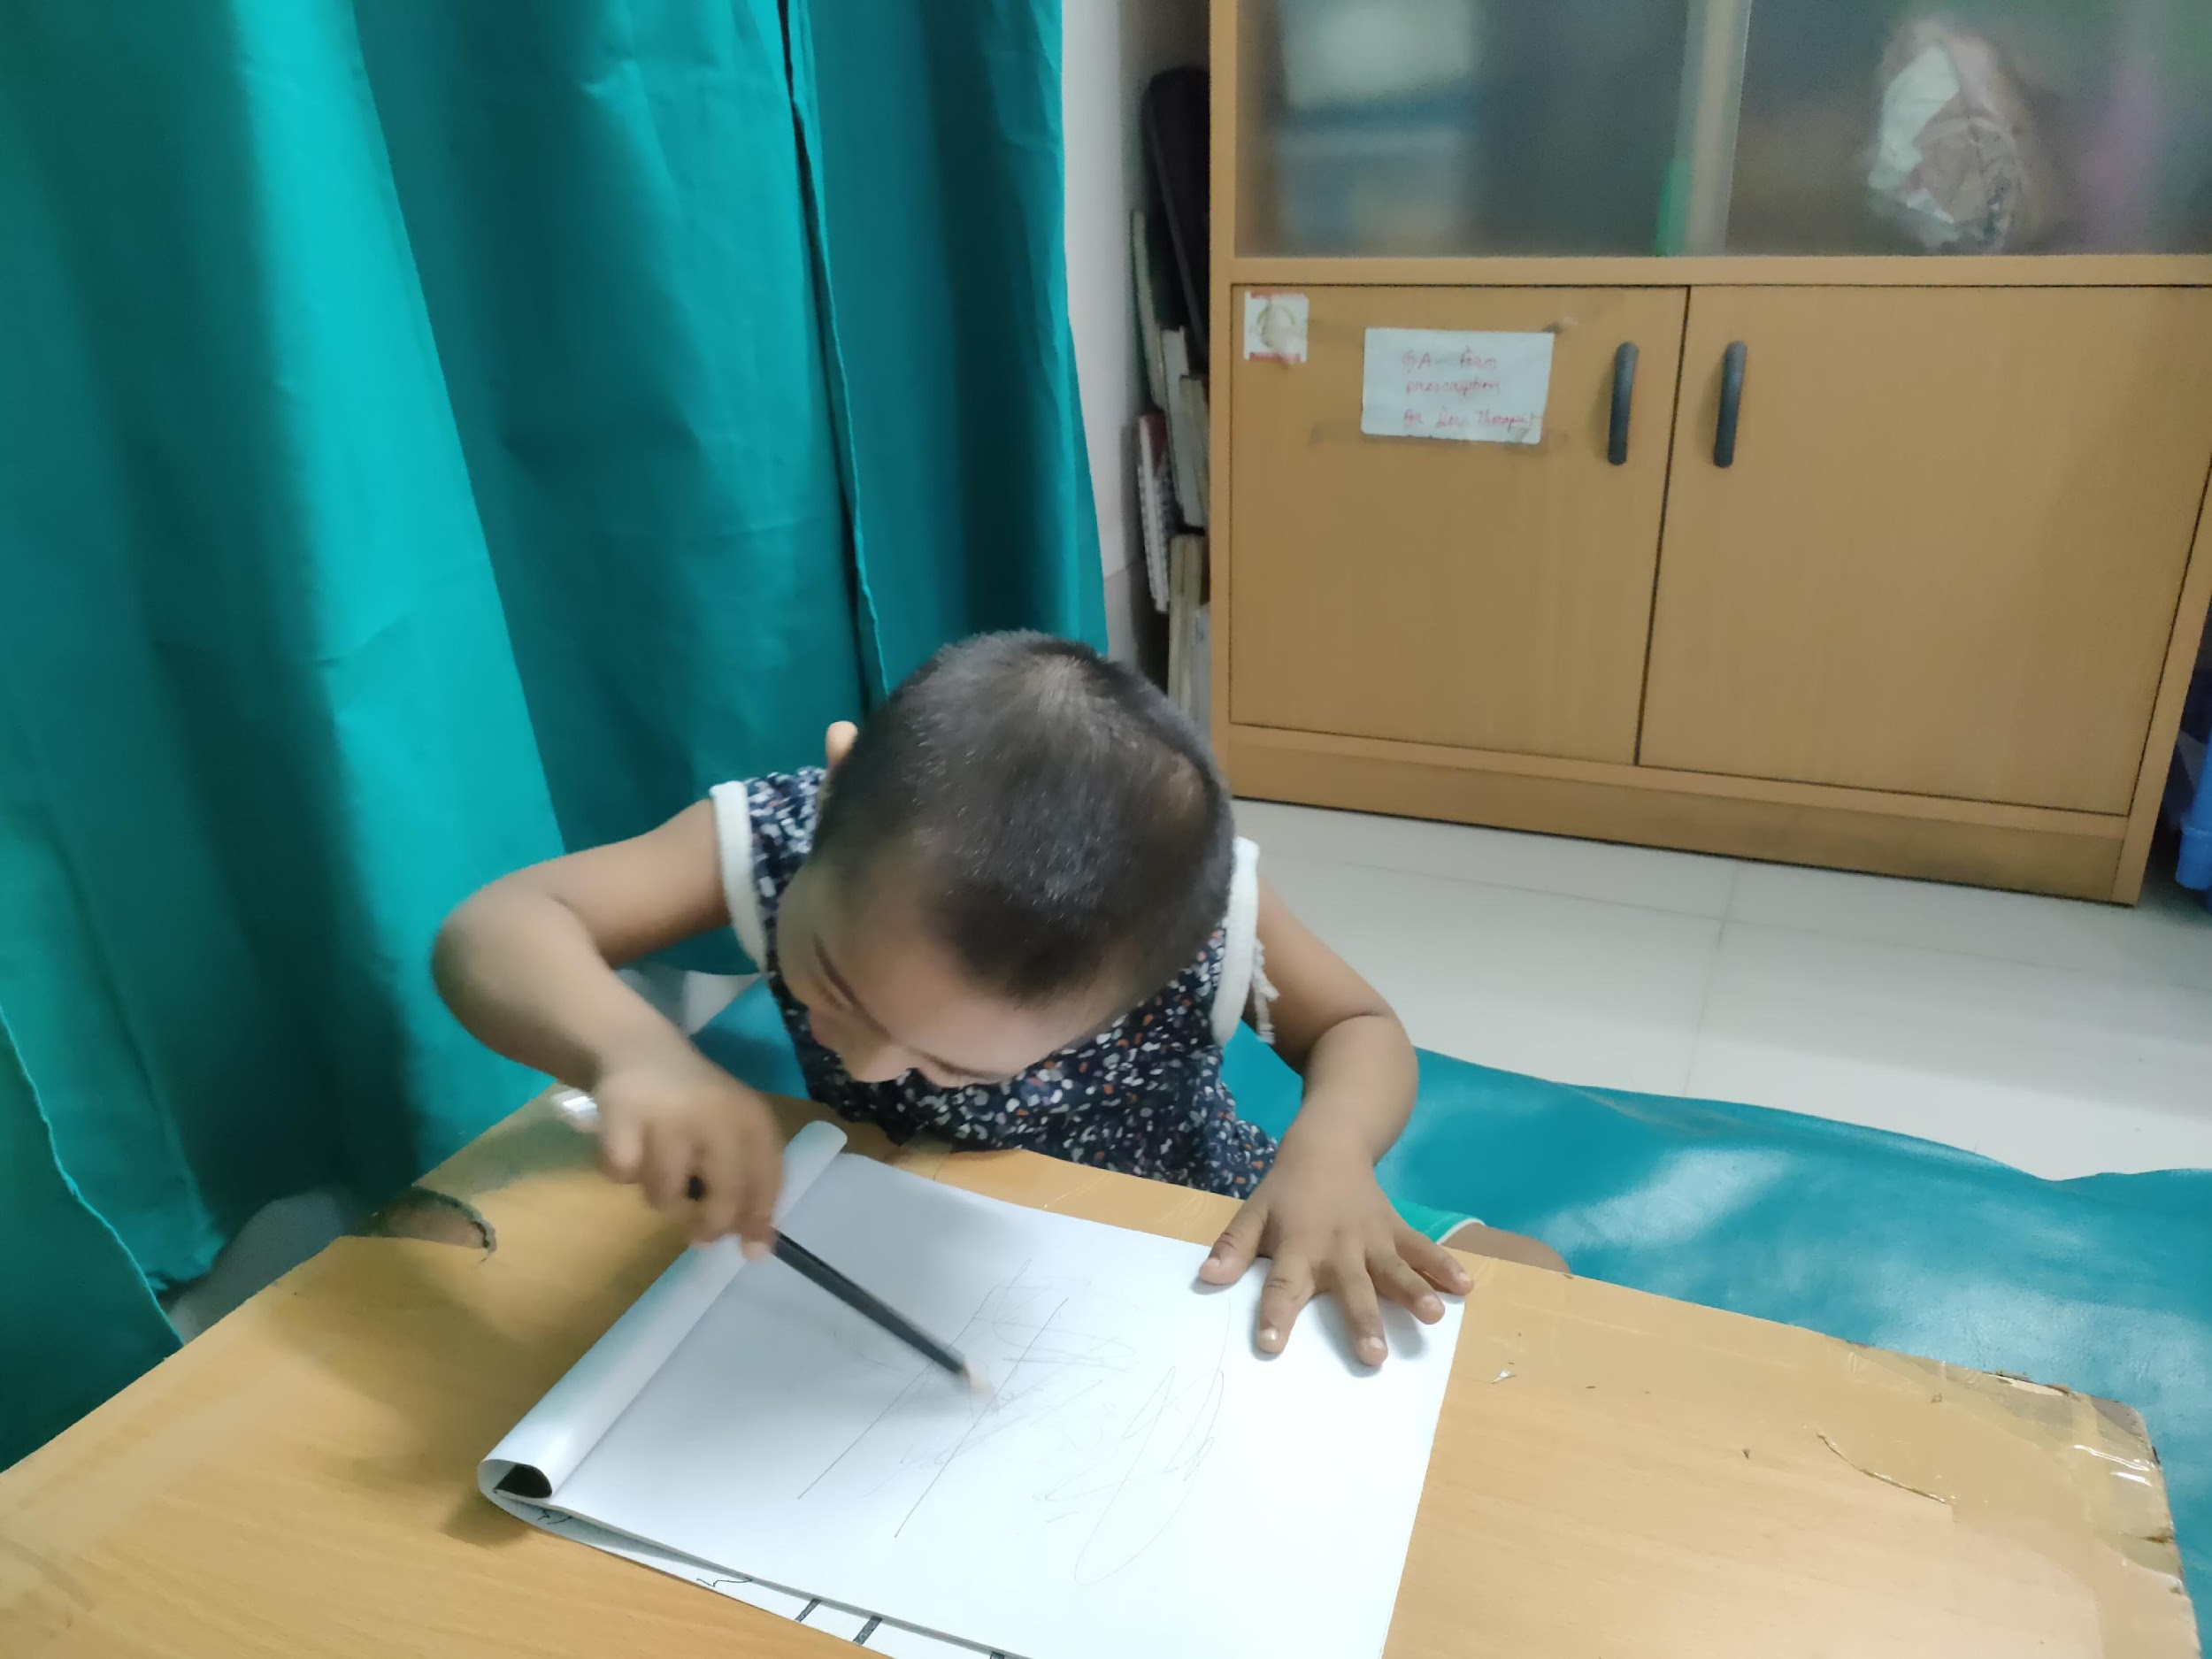
OUR ACTIVITIES

Slide 16
TOOLS IN USE
SCREENING & DIAGNOSTIC TOOLS: APPROPRIATE FOR THE CLINICAL CONDITION
RNDA FOR ALL CHILDREN.
GMFCS FOR CEREBRAL PALSY .
●MCHAT , ADOS FOR ASD .
CONNERS RATING SCALE,DSM - 5 FOR ADHD

Slide 17
TOTAL NUMBER OF PATIENTS WITH DOWN SYNDROME ATTENDING IN SBK
2021 | 71

Slide 18
SOCIODEMOGRAPHIC PROFILE OF DOWN SYNDROME IN SBK
AGE OF PRESENTATION IN MONTH
AGE IN MONTH | INCIDENCE
< 3 | 0
3 -12 | 9.85%
13 - 24 | 35.21%
25 - 36 | 23.94%
37 - 60 | 18.3%
> 60 | 12.67%

Slide 19
GENDER
MALE : FEMALE | 1.8 : 1
RESIDENCE
URBAN | 76.05%
RURAL | 23.94%

Slide 20
PARENT’S AGE
PATERNAL AGE | MATERNAL AGE
<35 YEARS 14.08% | <20 YEARS 9.85%
>35-40 YEARS 46.47% | 21-30 YEARS 49.29%
>40 YEARS 39.43% | 31-40 YEARS 40.84%

Slide 21
CLINICAL PROFILE OF DOWN SYNDROME
MOTOR DELAY | 46.47%
SPEECH DELAY | 100%
COGNITIVE DELAY | 100%
BEHAVIOR DELAY | 30.98%
SLEEP DISORDER | 18.30%
EPILEPSY | 21.12%
ACUTE STROKE SYNDROME | 1.3%

Slide 22
ASSOCIATION OF DOWN SYNDROME
HYPOTHYRODISM | 2.8%
CONGENITAL HEART DISEASE | 19.71%
MALIGNANCY | 1.3%
GASTRO INTESTINAL PROBLEM | 4.22%

Slide 23

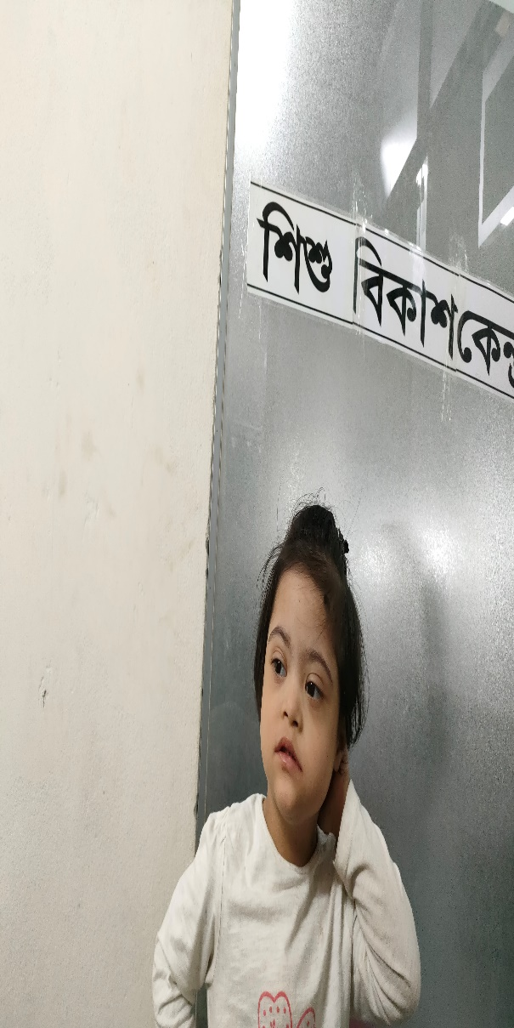

Slide 25


